Slide 1
KEYLOGGER
CAPSTONE PROJECT
Presented By:
Sherlin Britto - Jeppiaar Institute of Technology –B.E/ CSE

Slide 2
OUTLINE
Problem Statement
Proposed System/Solution
System Development Approach
Algorithm & Deployment
Result
Conclusion
Future Scope
References

Slide 3
PROBLEM STATEMENT
In today's digital age, security concerns are paramount, and one significant threat is keylogging, where an unauthorized entity can capture keystrokes to gain access to sensitive information. As such, there's a pressing need for tools to monitor and potentially mitigate such risks. The problem at hand is to develop a simple keylogger application to record keystrokes on a system and store them securely for analysis, with the aim of enhancing security awareness and potentially preventing malicious activities.

Slide 4
PROPOSED SOLUTION
The proposed solution is to develop a Python-based keylogger application using the pynput library and a graphical user interface (GUI) built with Tkinter. This application will run in the background, capturing keystrokes from the user. The captured data will then be stored both in a text file (key_log.txt) and a JSON file (key_log.json) for further analysis. The GUI will provide options to start and stop the keylogging process, enhancing user control and visibility over the application's operation.

Slide 5
SYSTEM APPROACH
The system will be developed using Python programming language, leveraging the pynput library for capturing keystrokes and Tkinter for building the GUI.
The application will consist of two main components:
Keylogger Module: This module will utilize the pynput.keyboard module to capture keystrokes. It will define functions to handle key press and release events, storing the captured keystrokes in memory and periodically writing them to the output files (key_log.txt and key_log.json).
Graphical User Interface (GUI): The GUI will be built using Tkinter, offering buttons to start and stop the keylogging process. It will also display status messages to the user, indicating whether the keylogger is active or not.
Technology Used:
Python: For programming the keylogger functionality.
Tkinter: For building the graphical user interface (GUI).
pynput: For capturing keyboard inputs.
JSON: For storing keystroke data in a structured format.

Slide 6
ALGORITHM & DEPLOYMENT
Initialization: Initialize necessary variables and flags.
Event Handling:
on_press(key): Records pressed and held keys.
on_release(key): Records released keys and manages flag state.
Logging:
generate_text_log(key): Saves keystrokes in a text file.
generate_json_file(keys_used): Saves keystrokes in a JSON file.
Keylogger Control:
start_keylogger(): Initiates keylogging process.
stop_keylogger(): Stops keylogging.

Slide 7
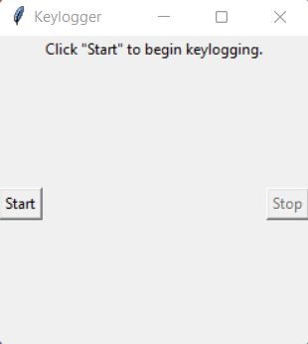
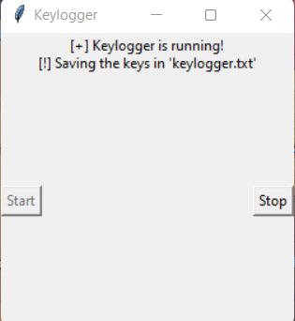
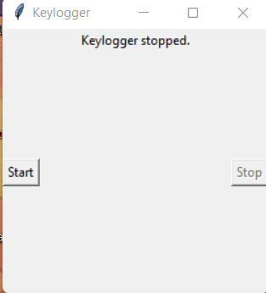
RESULT
The GUI presents "Start" and "Stop" buttons to control the keylogging process
Upon execution, the keylogger application will run in the background, capturing all keystrokes made by the user. The captured data will be stored in both text and JSON formats for later analysis.
The GUI will provide user-friendly controls to initiate and terminate the keylogging process, along with status updates.

Slide 8
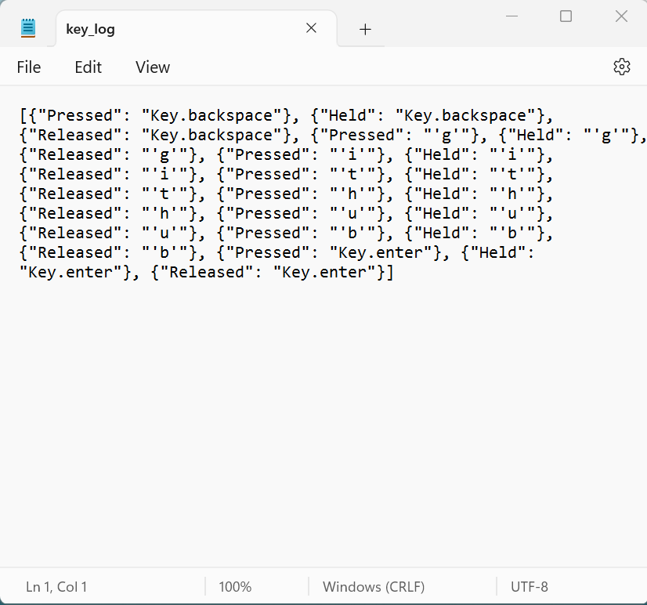
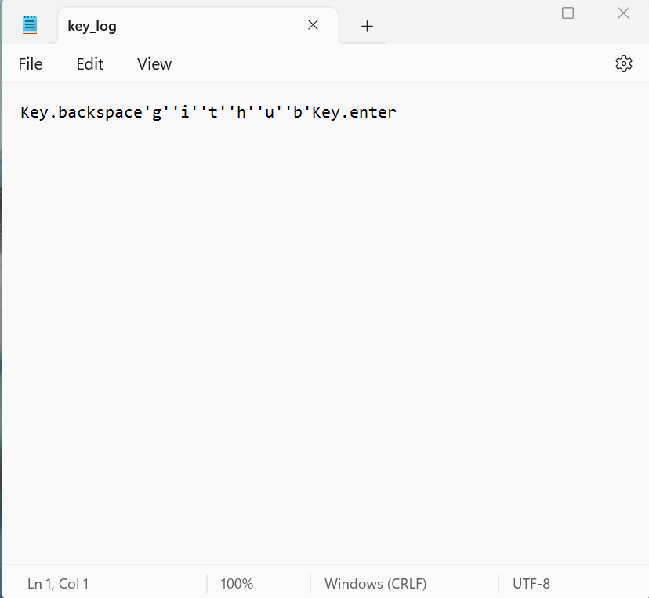
OUTPUT

Slide 9
CONCLUSION
The developed keylogger application provides a simple yet effective tool for monitoring keystrokes on a system. While primarily intended for security purposes, it can also serve as a learning tool for understanding keyboard events in Python programming. However, it's crucial to use such tools responsibly and ethically, respecting user privacy and legal boundaries.

Slide 10
FUTURE SCOPE
Encryption of captured keystrokes for enhanced security.
Addition of features to filter and analyze keystrokes based on specific criteria.
Integration with cloud storage services for remote data backup.
Implementation of machine learning algorithms for anomaly detection in keystroke patterns.

Slide 11
REFERENCES
A Survey on Keylogger and its Detection Techniques by Vishal Bharti, Aditya Kumar Gupta, and Shailendra Mishra https://www.ijcaonline.org/archives/volume75/number5/12835-1514
Analysis of Keylogger Attacks and Countermeasures by Hongliang Liu, Ruiying Du, and Quansheng Zhuang https://www.semanticscholar.org/paper/Analysis-of-Keylogger-Attacks-and-Countermeasures-Liu-Du/54c7255bace229c82e4a5fd812ba8dd8829180c1
Detection of Keyloggers: A Review by Shukor Abd Razak, Ku Ruhana Ku-Mahamud, and Ramlan Mahmod https://www.researchgate.net/publication/220955239_Detection_of_Keyloggers_A_Review
A Comprehensive Study on Keylogger Attack and Defense by Shuo Chen, Rui Wang, XiaoFeng Wang, and Kehuan Zhang https://www.usenix.org/legacy/events/sec11/tech/full_papers/Chen.pdf

Slide 12
THANK YOU

